Slide 1

Xverse

Slide 2
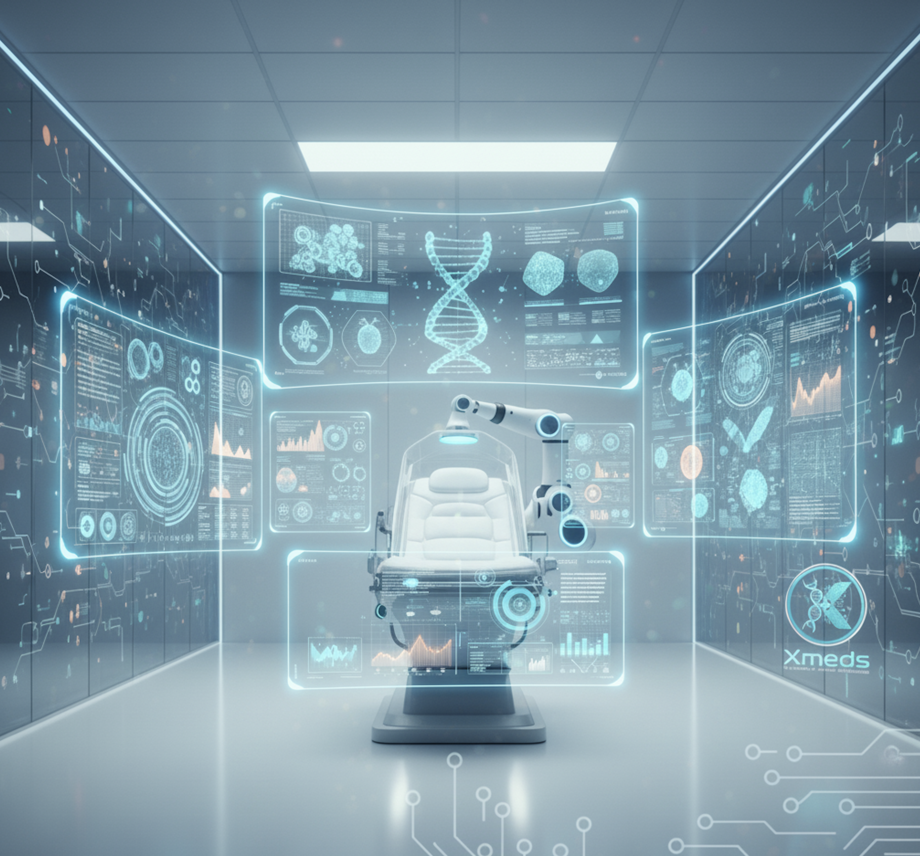
About Us
XMeds, a division of Xverse Technologies, is pioneering the transformation of modern medicine through the power of Artificial Intelligence. As a research-driven enterprise, we specialize in developing AI-assisted diagnostics, predictive modeling, and autonomous decision-support systems that empower clinicians, researchers, and healthcare organizations.
Our multidisciplinary team brings together expertise in Generative AI, Neural Networks, and Biomedical Data Science, translating complex biological and clinical datasets into actionable intelligence. From early disease detection to personalized treatment optimization, Xmeds is driving a new paradigm of precision, efficiency, and intelligence in healthcare.
Operating at the intersection of medical research and intelligent automation, we design solutions that enhance diagnostic accuracy, accelerate translational research, and improve patient outcomes.
As Artificial Intelligence continues to reshape the healthcare landscape, Xverse Technologies remains at the forefront—transforming data into diagnosis and discovery into better care.

Slide 3

Our Mission
At Xmeds, our mission is to advance the future of medicine by leveraging Artificial Intelligence to drive discovery, precision, and transformation across multiple diagnostic domains. We are committed to developing intelligent systems that bridge the gap between biomedical research and clinical application—empowering healthcare professionals with deeper insights, earlier interventions, and more personalized treatment strategies.
Our work spans a spectrum of diagnostic disciplines, from molecular and imaging-based analysis to behavioral and physiological modeling. By integrating Generative AI, Neural Networks, and Biomedical Data Science, we aim to decode the intricate relationships within biological and clinical data, enabling a more comprehensive understanding of health and disease.
Through rigorous research, ethical innovation, and strategic collaboration with clinicians and research institutions, Xmeds strives to redefine how diagnostics are discovered, validated, and delivered. Our mission is to make healthcare more predictive, precise, and profoundly patient-centric—turning scientific discovery into meaningful clinical impact.

Slide 4
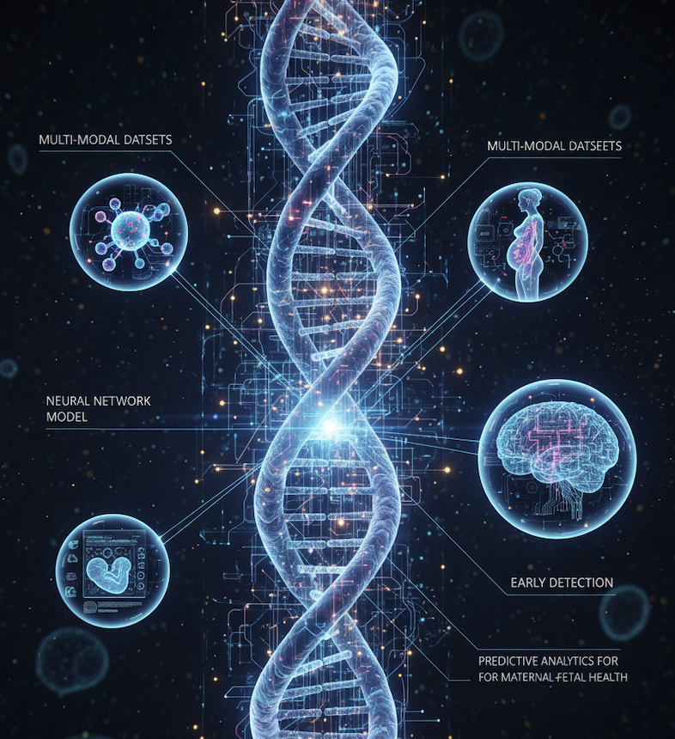
Our Project
At Xmeds, we are advancing the development of neural network–based AI models designed for the early detection and risk stratification of autoimmune disorders in pregnancy. Our research integrates deep learning architectures with clinical, immunological, and genomic data to identify subtle biomarkers and immunological patterns associated with maternal–fetal immune dysregulation. By leveraging multi-modal datasets—including biomarkers, patient histories, and genomic indicators—our models aim to predict the onset of autoimmune complications with enhanced accuracy, interpretability, and clinical applicability.
This initiative stems from the growing need for personalized and preventive approaches in maternal healthcare. Early recognition of immune-mediated risks enables clinicians to deliver timely interventions and targeted therapies, improving outcomes for both mother and child. Through this work, Xverse Technologies aims to bridge the gap between AI research and clinical practice, advancing the field of precision maternal medicine and redefining how autoimmune complications in pregnancy are understood, predicted, and managed

Slide 5
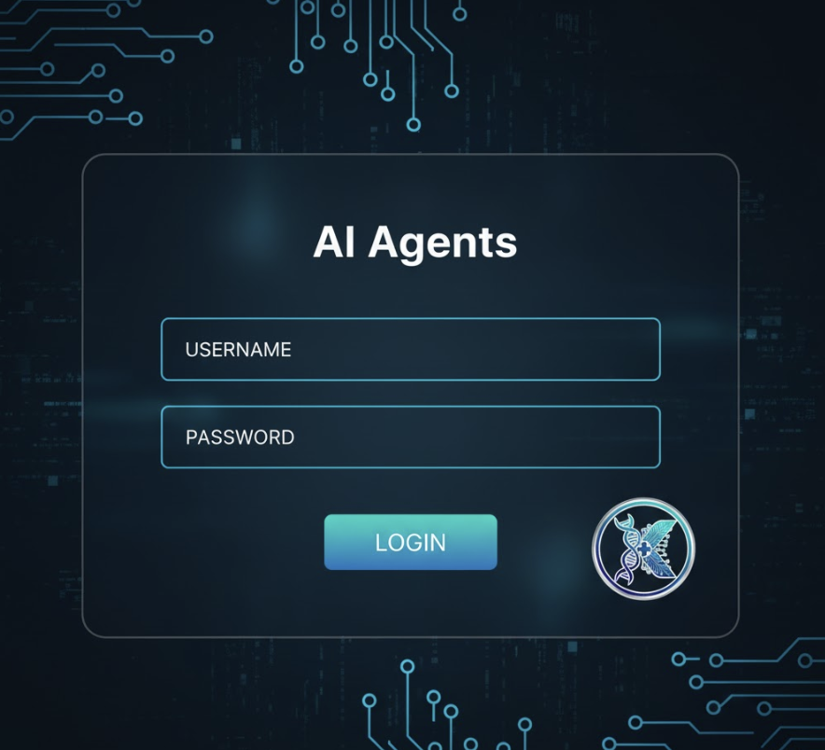
AI Agents

Slide 6
Page after giving login credentials
Patient Details
Patient ID
Patient Name
Patient Age
Parameter
We will give option to select Parameter from drop down and enter corresponding value
Add
Submit
Drop Down
Post Submit all details should come in tabular form
Run Diagnostic AI Model

Slide 7


Run Diagnostic AI Model
Animation showing as if model is running at the backend
LLM Generated Report
Gloop-flomp, the zizzle-wumpkin burbled, causing the chromatically challenged snorfnagle to spontaneously combust into a puff of glitter-infused moonbeams. Qwertyuiop grumbled, adjusting its asymmetrical gribble-widget, wondering if the blibbity-blab was truly ready for interdimensional sock-puppetry. Meanwhile, down in the frobbled-doo, the preposterous squibble-doodle continued its tireless quest for the legendary cheese-flavored earwax of Zorp.
Final Graphical report (this will come from ML model)
Save
Print

